Slide 1
CSE422 : ARTIFICIAL INTELLIGENCE
LAB01
INTRODUCTION TO PYTHON
Prepared By Md Rezwan Hassan Khan
Slides Prepared by : Md Rezwan Hassan Khan
Ismail Hossain
Rifa Aziz
Sifat Ut Taki

Slide 2
Topics :
How to initialize a variable
Standard Data Types
String
List
Tuples
Dictionaries
Input Function and Type Conversation
Conditional Statement
Loops
Function

Slide 3
Colab Link
https://colab.research.google.com/drive/1VFdwY4hbUSuJa-vGWQd5ApcSxx58et0f?ts=5e284d0f

Slide 4
How to initialize a variable
a = 1 # integer
b = 1.1 # float
c = 1 + 2j # complex number (a + bi)
d = “a” # string
e = True # boolean (True / False)
In Java:
int a= 12;
string a= “cse110”
Comment starts with a #
Example:
# this is a comment

Slide 5
Standard Data Types
String
Numbers(int,long,float,complex)
List
Tuple
Dictionary
Sets

Slide 6
Strings
String: A sequence of characters in a program
Starts and ends with quotation mark(" ") or apostrophe (‘ ’)
You can use either one you want
Examples:
'Hello'
'One Valid String'
"This is also a valid String”
'This However is a valid "String" because maintains the order of quotation and apostrophe'
'This is not valid String"
'This is not valid String either!
'String inside a 'String' is not allowed'

Slide 7
More on Strings
You cannot write multi-line Strings with (“ ”) or (‘ ’)
‘This is
Not a valid
String’
Multi-line String starts and ends with Triple apostrophe (‘’’……‘’’)
‘’’ Now we
Can write
Multi-line Strings’’’

Slide 8
Special Characters
>>>print('He said "let's go "')
This gives error.
We can represent special characters by preceding backslash
\n for new line
\t for tab
\\ for backslash
\" for quotation character
>>> print('He said "let\'s go "')
He said "let's go"

Slide 9
String Indexing
All characters are indexed in String
Indexes start from 0
>>> sentence = 'Loving CSE422’ sentence[index]=char
>>> print('1st character of sentence is', sentence[0])
1st character of sentence is L
>>>print('last character of sentence is', sentence[12])
last character of sentence is 0
WHAT IF I DO NOT KNOW THE LAST INDEX?
>>> print('last character of sentence is', sentence[-1])
last character of sentence is 0
//negative index shows the index from the end
Indexes | 0 | 1 | 2 | 3 | 4 | 5 | 6 | 7 | 8 | 9 | 10 | 11 | 12
Characters | L | o | v | i | n | g |  | C | S | E | 4 | 2 | 2
>>> print(sentence[13])
IndexError: string index out of range

Slide 10
String Mutability
Strings are immutable:
Strings cannot be changed:
can't be appended to
can't change elements
can’t delete items
>>> sentence = 'Loving CSE422'
>>>sentence[0] = 'l'
TypeError: 'str' object does not support item assignment

Slide 11
String Operation
Concatenation
Operation of joining character Strings end-to-end
glues together 2 strings by + operator
>>> print('Hello'+'World!')
HelloWorld No space
>>> line = 'Hello' + 'World' >>> print(line)
HelloWorld

Slide 12
String Operation
>>> print('Hello\n' * 5)
Hello
Hello
Hello
Hello
Hello
Repetition
Used for repeating Strings
Great feature that can be used instead of loops
>>> print('Hello’ * 5)
HelloHelloHelloHelloHello
>>>for count in range(5): print('Hello')
Hello
Hello
Hello
Hello
Hello

Slide 13
String Operation
Slicing
Slicing in Python is a feature that enables accessing parts of sequences like strings, tuples, and lists.
Used for extracting substring from a large string
>>>course = 'CSE422’ #print only 422 from the String course
>>> for index in range(3,6): print(course[index])
110
>>>print(course[3:])
110

Slide 14
String Operation
index | 0 | 1 | 2 | 3 | 4 | 5 | 6 | 7 | 8 | 9 | 10
character | H | e | l | l | o |  | W | o | r | l | d
Anatomy of Slicing
string_name[ beginning: end: step]
# where python should start slicing. inclusive.
# where should python stop slicing. Not inclusive.
#Step is optional. (Integar value which determine the increment between each index)
>>>temp = 'Hello World' >>> print(temp[0:2])
He
>>> print(temp[:2])
He
>>> print(temp[5:])
World
>>> print(temp[1:8:2])
el o
>>> print(temp[0::2])
HloWrd
>>> print(temp[:])
Hello World

Slide 15
Logical operator in
We can use in keyword to find if there is occurrence of any substring in a given String
>>>'bay' in 'ebay' True
>>>'Bay' in 'Ebay' False
>>>'bay’ not in 'ebay' False
>>>'Bay' not in 'Ebay' True

Slide 16
String Operations
temp1 = 'Hello'
tem2 = 'World'
Operator | Meaning | Example
+ | Concatenation | temp1 + temp2
* | Repetition | temp1*3
string_name[] | Indexing | temp2[4]
string_name[:] | Slicing | temp1[:3] + temp2[3:]
len(string_length) | Length | len(temp1)
For var in string_name: | Iteration through characters | for character in temp1: print character

Slide 17
ASCII
Machines do not understand text. Not even decimals.
Only binary
To convert String into binary, we at least need to convert Strings into numbers
ASCII (American Standard Code for Information Interchange) is a code for representing English characters as numbers, assigned from 0 to 127
>>> ord('a')
97
>>> ord('b')
98
>>> chr(97)
'a'
#Returns the corresponding ASCII values of a character
#Returns the corresponding string of a number

Slide 18
String functions
There are number of functions in python String library
string_name.function_name()
String functions do not change the string itself, instead, they return a modified String
saves us a lot of time

Slide 19
String functions
lower() returns a copy string with all lower case letter
upper() returns a copy string with all lower case letter
strip() returns a copy string with all whitespace remove before and after letters
count(substring) returns total occurrence of substring
startswith(substring) returns True if the String starts with given substring
endswith(substring) returns True if the String starts with given substring
find(substring) returns the index of first occurrence of substring
replace(oldstring, newstring) replace every instance of oldstring with newstring
>>>line = 'Hello World' >>> temp = line.lower()
>>> print(line)
Hello World
>>>print(temp)
hello world
>>> ' BracU CSE110 '.strip() 'BracU CSE110'
>>> ' BracU '.lstrip() 'BracU '
>>> ' Bracu '.rstrip() ' Bracu' >>> 'Bangladesh'.count('a') 2
>>> 'Bangladesh'.find('a') 1
>>> 'Hello'.replace('l', 'nt') 'Hentnto’
>>> 'Hello'.startswith('He’)
True

Slide 20
String functions
>>> dir('this is a string’)
>>> dir(' ‘)
['__add__', '__class__', '__contains__', '__delattr__', '__dir__', '__doc__', '__eq__', '__format__', '__ge__', '__getattribute__', '__getitem__', '__getnewargs__', '__gt__', '__hash__', '__init__', '__init_subclass__', '__iter__', '__le__', '__len__', '__lt__', '__mod__', '__mul__', '__ne__', '__new__', '__reduce__', '__reduce_ex__', '__repr__', '__rmod__', '__rmul__', '__setattr__', '__sizeof__', '__str__', '__subclasshook__', 'capitalize', 'casefold', 'center', 'count', 'encode', 'endswith', 'expandtabs', 'find', 'format', 'format_map', 'index', 'isalnum', 'isalpha', 'isascii', 'isdecimal', 'isdigit', 'isidentifier', 'islower', 'isnumeric', 'isprintable', 'isspace', 'istitle', 'isupper', 'join', 'ljust', 'lower', 'lstrip', 'maketrans', 'partition', 'replace', 'rfind', 'rindex', 'rjust', 'rpartition', 'rsplit', 'rstrip', 'split', 'splitlines', 'startswith', 'strip', 'swapcase', 'title', 'translate', 'upper', 'zfill’]
https://docs.python.org/3/library/stdtypes.html#string-methods

Slide 21
Input Function and Data Type Conversation

Slide 22
User input: input() function
The simplest way to take input from the user is
input(‘prompt’) 🡪 It will read line from keyboard.
input() pauses program execution to allow the user to type in a line of input from the keyboard. Once the user presses the Enter key, all characters typed are read and returned as a string.
IN JAVA
>>> import java.util.Scanner;
class Cse422
{
public static void main(String[args]
{
Scanner sc=new Scanner(System.in)
System.out.println(“Enter your name:”)
String s=sc.nextLine();
System.out.println(s)
}
}
Output will be: Alice
IN PYTHON:
>>> s = input(“Enter your name:”)
>>> print(s)
Output will be: Alice

Slide 23
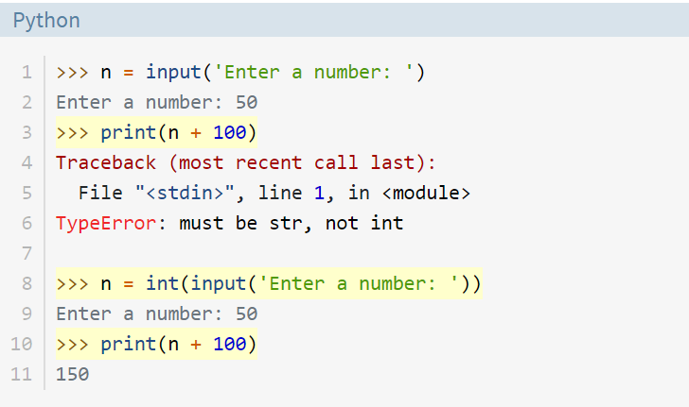
Limitation of input() function
input() always returns a string. If you want a numeric type, then you need to convert the string to the appropriate type with the int(), float() or str() which are built-in functions:
In the example,
the expression n + 100 on line-3
is invalid as n is a string and
100 is an integer.
Line 8 converts the input string to an integer. So the print() statement on line 10 succeeds.

Slide 24
Type Conversion in Python (Casting)
int() : constructs an integer number from an integer literal, a float literal or a string literal
float() : constructs a float number from an integer literal, a float literal or a string literal
str() : constructs a string from a wide variety of data types, including strings, integer literals and float literals
Examples:
x = int(1) # x will be 1
y = int(2.8) # y will be 2
z = int("3") # z will be 3
y = float(2.8) # y will be 2.8
z = float("3") # z will be 3.0
w = float("4.2") # w will be 4.2
s = str(12.5) # s will be 12.5

Slide 25
Conditional Statement

Slide 26
Operators
Equals: a == b (True, if a and b are equals)
Not Equals: a != b (True, if a and b are not equals)
Less than: a < b (True, if a is less than b)
Less than or equal to: a <= b (True, if a is less than or equal b)
Greater than: a > b (True, if a is greater than b)
Greater than or equal to: a >= b (True, if a is greater than or equal b)
in keyword
is keyword

Slide 27
Example of if Statement
In Python:
a = 16;
if a > 10:
|print(“a is greater than 10”)
print(“code ended”)
In Java
int a = 16;
if (a > 10)
{
System.out.println(“a is greater than 10”);
}
System.out.println(“code ended”);

Slide 28
Example of if..else Statement
x = 16
If x % 2 == 0:
print(“Even number”)
else:
print(“Odd number”)

Slide 29
Example of if..elif..else
if it is sunny:
I'll play cricket
elif it is rainy:
I'll play football
else:
I'll play indoors

Slide 30
Standard Data Type : List
A list is an ordered sequence of values :
List=[1.5, 4, ‘sdf’, 5, 2, 89]
where each value is identified by an index.
List[0]=1
Commas separate the elements that are contained within a list :
List=[1.5, 4, ‘sdf’, 5, 2, 89]
enclosed in square brackets. [ ]

Slide 31
List vs Arrays
Arrays in Java
List in Python
A array can store one a fix data type values [homogeneous element]
Array=[1, 2, 5, 2, 89]
A list can store any data type values [heterogeneous elements]
List=[1.5, 4, ‘sdf’, 5, 2, 89]

Slide 32
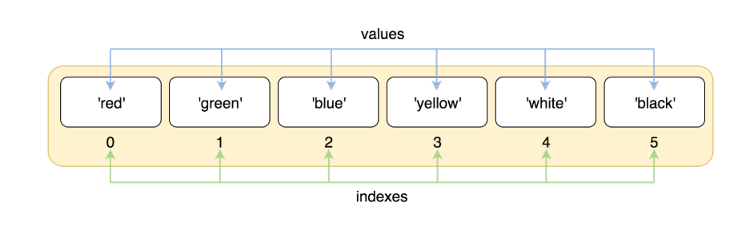
Indexing

Slide 33
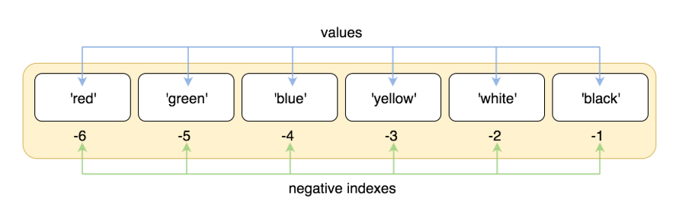
Negative indexes

Slide 34
Mutability
Mutability is the ability for certain types of data to be changed without entirely recreating it.
Code | Output
list_1 = [1, 2, 3] list_1[0] = 4 list_1[1] = 5 list_1[2] = 6 list_1.append(7) print(list_1) | [4, 5, 6, 7]

Slide 35
Methods Associated with Lists
L.append(e) | adds the object e to the end of L.
L.count(e) | returns the number of times that e occurs in L.
L.insert(i, e) | inserts the object e into L at index i.
L.extend(L1) | adds the items in list L1 to the end of L.
L.remove(e) | deletes the first occurrence of e from L.
L.index(e) | returns the index of the first occurrence of e in L.
L.pop(i) | removes and returns the item at index i in L. If i is omitted, it defaults to -1, to remove and return the last element of L.
L.sort() | sorts the elements of L in ascending order.
L.reverse() | reverses the order of the elements in L.

Slide 36
Built-in Methods of Lists with Examples
Method | Code | Output
append() | subjects = ['CSE', 'EEE', 'Civil'] subjects.append('Mechanical') print(subjects) | ['CSE', 'EEE', 'Civil', 'Mechanical']
count() | subjects = ['CSE', 'EEE', 'Civil', 'CSE'] x = subjects.count('CSE') print(x) | 2
insert() | subjects = ['CSE', 'EEE', 'Civil'] subjects.insert(1, 'Mechanical') print(subjects) | ['CSE', 'Mechanical', 'EEE', 'Civil']
extend() | subjects = ['CSE', 'EEE', 'Civil'] cars = ['Ford', 'BMW', 'Volvo'] subjects.extend(cars) print(subjects) | ['CSE', 'EEE', 'Civil', 'Ford', 'BMW', 'Volvo']
remove() | subjects = ['CSE', 'EEE', 'Civil'] subjects.remove('Civil') print(subjects) | ['CSE', 'EEE']
index() | subjects = ['CSE', 'EEE', 'Civil'] x = subjects.index('Civil') print(x) | 2
pop() | subjects = ['CSE', 'EEE', 'Civil'] subjects.pop(1) print(subjects) | ['CSE', 'Civil']
sort() | cars = ['Ford', 'BMW', 'Volvo'] cars.sort() print(cars) | ['BMW', 'Ford', 'Volvo']
reverse() | subjects = ['CSE', 'EEE', 'Civil'] subjects.reverse() print(subjects) | ['Civil', 'EEE', 'CSE']

Slide 37
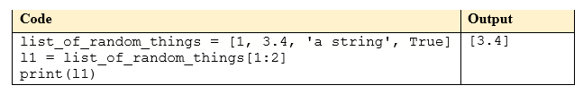

Slicing
Slicing is the easiest way to pull more than one value from a list at a time by using slicing.
lower index is inclusive
the upper index is exclusive
list_name[ beginning: end]
# beginning : where python should start slicing. (inclusive)
# end : where should python stop slicing. (exclusive)
index 0 1 2 3
Example:

Slide 38
Standard Data Type : Tuples
Tuples is almost same as a list except few exception.
Tuples is an object type that has ordered sequence of :[heterogeneous elements]
Tuple is immutable (not-changeable)

Slide 39
Tuples vs List
List
Tuple
List=[ ]
List=[1,2,3.4, ‘dfggh’,45]
Mutable(add,remove and change values)
List has more built in method than tuple
List occupy more memories
Tuple=( )
Tuple=(1,2,3.4, ‘dfggh’,45)
Immutable
Tuple has less built in methods
Occupy less memories

Slide 40
Creating a tuple
Empty tuple :
tup1=()
Creating a tuple is as simple as putting different comma-separated values:
tup1 = ('physics', 'chemistry', 1997, 2000);
tup2 = (1, 2, 3, 4, 5 );
tup3 = "a", "b", "c", "d";
To write a tuple containing a single value you have to include a comma, even though there is only one value :
tup1 = (50,);

Slide 41
Indexing and Slicing :Same as List
Indexing
Slicing
Tuple_name[ beginning: end]
# beginning : where python should start slicing. (inclusive)
# end : where should python stop slicing. (exclusive)

Slide 42
Accessing Values in Tuples
tup1 = ('physics', 'chemistry', 1997, 2000);
tup1[index]=value
Example :
1.print(tup1[2]) output 1997
2. print(tup1[1:3]) output [chemistry,1997}

Slide 43
Updating Tuples
Tuples are immutable which means you cannot update or change the values of tuple elements.
You are able to take portions of existing tuples to create new tuples as the following example demonstrates −
tup2 = (1, 2, 3, 4, 5 );
# Following action is not valid for tuples :
tup1[0] = 100;
Tup1=(1,2,3)
Tup2=(‘a’, ‘b’, ‘c’)
Create new tuples :
Tup3=Tup1+Tup3
Output :
(1,2,3, ‘a’, ‘b’, ‘c’)

Slide 44
Delete Tuples Elements
Tup1=(1,2,4)
del Tup1

Slide 45
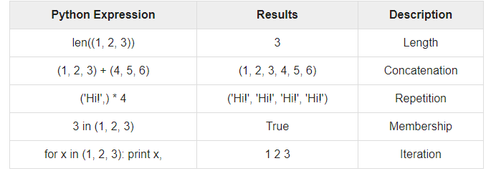
Basic Tuples Operations

Slide 46
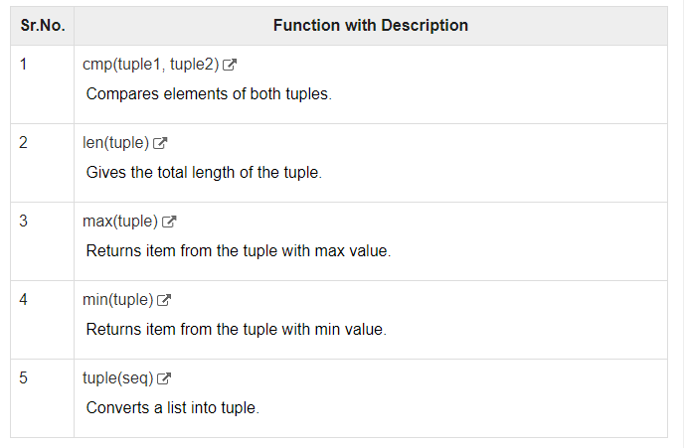
Built-in Tuples Functions

Slide 47
For Loops
A for loop is used for iterating over a sequence (that is either a list, a tuple, a dictionary, a set, or a string).

Slide 48
For Loops
IN JAVA
IN PYTHON
for (int i = 0; i < 10; i +=1) System.out.println(i);
for (int i = 0; i < 10; i +=3) System.out.println(i);
for i in range(0, 10): print(i)
for i in range(0, 10, 3): print(i)

Slide 49
Iterating over a List
Iterating over a tuple
l = ["geeks", "for", "geeks"]
for i in l:
print(i)
t = ("geeks", "for", "geeks")
for i in t:
print(i)

Slide 50
Iterating over a String
Iterating over a Dictionary
s = "Geeks"
for i in s :
print(i)
We will look at dictionary tutorial

Slide 51
Dictionaries

Slide 52
List
Collection of items in a order sequence
Can fetch/access value in a list through integer indexes

Slide 53
Key-value Pair
Lists have integer indices associated with each values. Random access to a certain value using the corresponding index number is possible. But what if we could replace indices with something more meaningful?
Dictionaries replace integer index with keys. Just like index numbers, a key is a unique identifier for an item in a Collection. A key can be any immutable data type (Integer, Float, String, Boolean etc.).
Index | Item
0 | 'John'
1 | 'Wick'
2 | 55
3 | True
key | Item
'First Name' | 'John'
'Last Name' | 'Wick'
'Age' | 55
'hasDog' | True
Replacing indices with meaningful keys

Slide 54
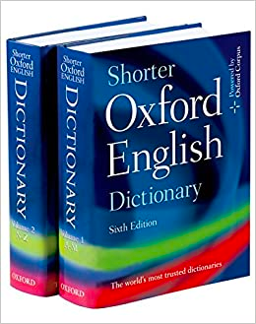
Key-value Pair (Example)
List and dictionaries are similar. Instead of using index integers, a Dictionary uses key to find a specific value.
For example, think of a dictionary in real life. It has words along with its definition associated with it. Here,
Word = key
Definition = value
To find the meaning of a word, first you have to look for the word (key). Once you’ve find your desired word (key), then you can easily see it’s definition (value).
Note that each and every word in a dictionary is distinctive however, definition of multiple words can be identical. Similarly in python, keys have to be distinctive but not the values.

Slide 55
Creating a Dictionary
'Apple' | 'Mango' | 'Mango' | 'Raspberry ' | 'Blueberry ' | 'Grape'
'Germany' | 'India' | 'Haiti' | 'UK' | 'USA' | 'Spain'
Let’s create this example using Python Dictionary.
>>> national_fruits = { 'Germany' : 'Apple', 'India' : 'Mango', 'Haiti' : 'Mango', 'UK' : 'Raspberry', 'USA' : 'Blueberry', 'Spain' : 'Grape' }
>>> print(national_fruits)
{'USA': 'Blueberry', 'India': 'Mango', 'Germany': 'Apple', 'UK': 'Raspberry', 'Haiti': 'Mango', 'Spain': 'Grape'}
>>> national_fruits = dict() >>> national_fruits['Germany'] = ['Apple'] >>> national_fruits['India'] = ['Mango'] >>> national_fruits['Haiti'] = ['Mango'] >>> national_fruits['UK'] = ['Raspberry'] >>> national_fruits['USA'] = ['Blueberry'] >>> national_fruits['Spain'] = ['Grape']
>>> print(national_fruits)
OR
Notice that printing order of the Dictionary does not match the insertion order. It is because, unlike Lists, python (3.7+) does not keep the order of insertion for Dictionaries.

Slide 56
Adding a New Value
'Apple' | 'Mango' | 'Mango' | 'Raspberry ' | 'Blueberry ' | 'Grape'
'Germany' | 'India' | 'Haiti' | 'UK' | 'USA' | 'Spain'
To add a value to an existing dictionary, you need to provide a new key along with its value.
>>> national_fruits['Austria'] = 'Apple'
'Apple' | 'Mango' | 'Mango' | 'Raspberry ' | 'Blueberry ' | 'Grape' | 'Apple'
'Germany' | 'India' | 'Haiti' | 'UK' | 'USA' | 'Spain' | 'Austria'
>>> print(national_fruits['Austria'])
Apple

Slide 57
Modifying an Existing Value
'Apple' | 'Mango' | 'Mango' | 'Raspberry ' | 'Blueberry ' | 'Grape' | 'Apple'
'Germany' | 'India' | 'Haiti' | 'UK' | 'USA' | 'Spain' | 'Austria'
To modify an existing value, you need to provide the corresponding key along with a new value.
>>> national_fruits['Austria'] = 'Orange'
'Apple' | 'Mango' | 'Mango' | 'Raspberry ' | 'Blueberry ' | 'Grape' | 'Orange'
'Germany' | 'India' | 'Haiti' | 'UK' | 'USA' | 'Spain' | 'Austria'
>>> print(national_fruits['Austria'])
Orange

Slide 58
Deleting a Key
'Apple' | 'Mango' | 'Mango' | 'Raspberry ' | 'Blueberry ' | 'Grape' | 'Orange'
'Germany' | 'India' | 'Haiti' | 'UK' | 'USA' | 'Spain' | 'Austria'
To delete an existing key, you need use the del keyword.
>>> del national_fruits['Austria']
>>> print(national_fruits['Austria'])
KeyError: 'Austria'
You can also use the pop() function if you want to store the deleted value in a variable.
>>> deleted_value = national_fruits.pop('Austria') >>> print(deleted_value)
Orange

Slide 59
Iterating a Dictionary
'Apple' | 'Mango' | 'Mango' | 'Raspberry ' | 'Blueberry ' | 'Grape'
'Germany' | 'India' | 'Haiti' | 'UK' | 'USA' | 'Spain'
We can get the length of the dictionary using len() function:
>>> print(len(national_fruits))
6
We can get the keys of the dictionary using keys() function:
>>> print(national_fruits.keys())
['USA', 'India', 'Germany', 'UK', 'Haiti', 'Spain’]
We can get the values of the dictionary using values() function:
>>> print(national_fruits.values())
['Blueberry', 'Mango', 'Apple', 'Raspberry', 'Mango', 'Grape’]
We can get the key-value pairs of the dictionary using items() function:
>>> print(national_fruits.items())
[('USA', 'Blueberry'), ('India', 'Mango'), ('Germany', 'Apple'), ('UK’, 'Raspberry'), ('Haiti', 'Mango'), ('Spain', 'Grape')]

Slide 60
Iterating a Dictionary (Cont.)
If you want to run loop like a List, it will loop through the keys only:
>>> for i in national_fruits: print(i)
USA
India
Germany
UK
Haiti
Spain
You can also iterate through the keys using:
>>> for key in national_fruits.keys(): print(key)
USA
India
Germany
UK
Haiti
Spain
To iterate through the values use:
>>> for val in national_fruits.values(): print(val)
Blueberry
Mango
Apple
Raspberry
Mango
Grape
To iterate through the key-value pair use:
>>> for key, val in national_fruits.items(): print(key, val)
('USA', ['Blueberry'])
('India', ['Mango'])
('Germany', ['Apple'])
('UK', ['Raspberry'])
('Haiti', ['Mango'])
('Spain', ['Grape'])

Slide 61
Sorting a Dictionary
We can sort a Dictionary either by its keys or values using the sorted() function.
Sorting by key:
>>> sorted_national_fruits_keys = sorted(national_fruits.keys()) >>> print(sorted_national_fruits_keys)
['Germany', 'Haiti', 'India', 'Spain', 'UK', 'USA’]
Sorting by value:
>>> sorted_national_fruits_values = sorted(national_fruits.values()) >>> print(sorted_national_fruits_values)
[['Apple'], ['Blueberry'], ['Grape'], ['Mango'], ['Mango'], ['Raspberry']]

Slide 62
Dictionary Functions
clear() | Removes all the elements from the dictionary
copy() | Returns a copy of the dictionary
fromkeys() | Returns a dictionary with the specified keys and value
get() | Returns the value of the specified key
items() | Returns a list containing a tuple for each key value pair
keys() | Returns a list containing the dictionary's keys
pop() | Removes the element with the specified key
popitem() | Removes the last inserted key-value pair
setdefault() | Returns the value of the specified key. If the key does not exist: insert the key, with the specified value
update() | Updates the dictionary with the specified key-value pairs
values() | Returns a list of all the values in the dictionary
Official documentation: https://docs.python.org/3/tutorial/datastructures.html#dictionaries

Slide 63
Function
def increment(number, by):
return number + by
n = 1
while (n < 10):
print(n)
n = increment(n, 1)

